Slide 1
From Pets to Cattle: Learning to let go and automate
Anthony Howell
@theposhwolf
1 / 15

Slide 2


Slide 3

Content
github.com/theposhwolf/sessions

Slide 4


Who am I?
Anthony Howell
Natural Intelligence hosted on human hardware
Eugene, OR USA
4 kids, 2 dogs, 1 wife
Cloud Platform Architect
Focus on containerization

Slide 5
Picture

Slide 6
Demo Disclaimer

Slide 7
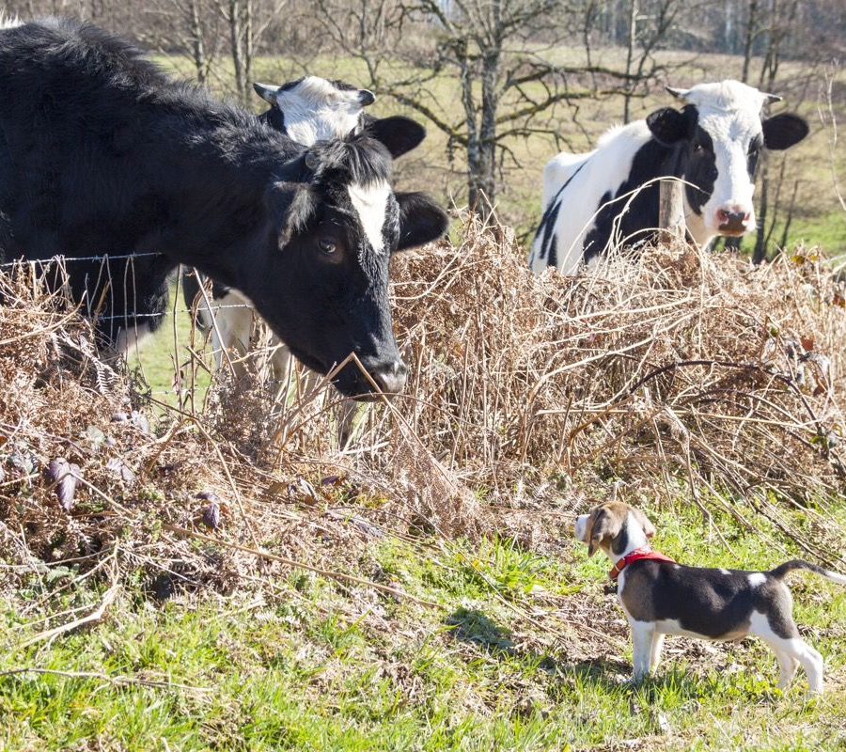
Overview
Pets vs Cattle: Real life
Quiz!
Pets vs Cattle: Infrastructure
Problem signs
Recovery strategies
What’s next?

Slide 8
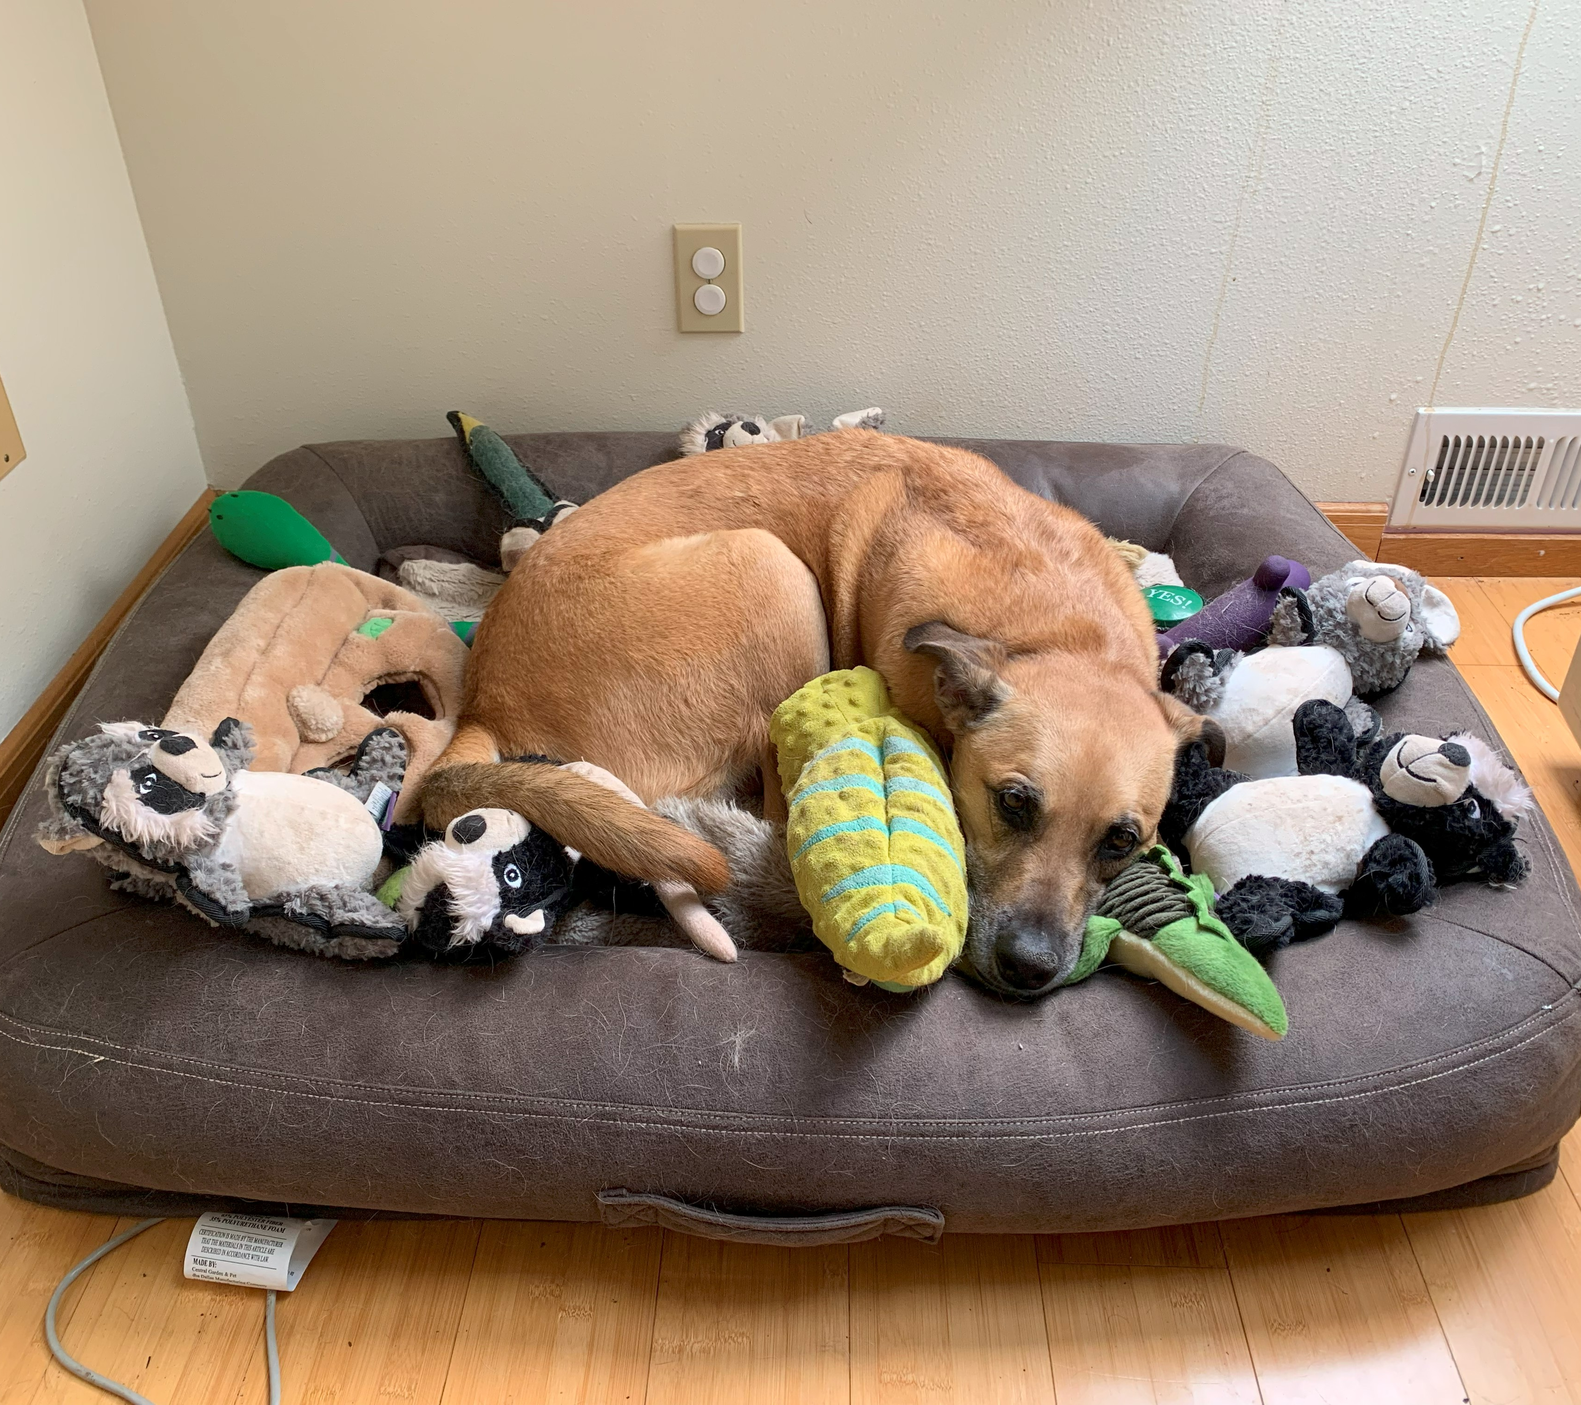
What are pets?
They sleep in our beds
They snuggle with our children
They lick our faces
We clean up their messes
We love them because they are part of the family

Slide 9
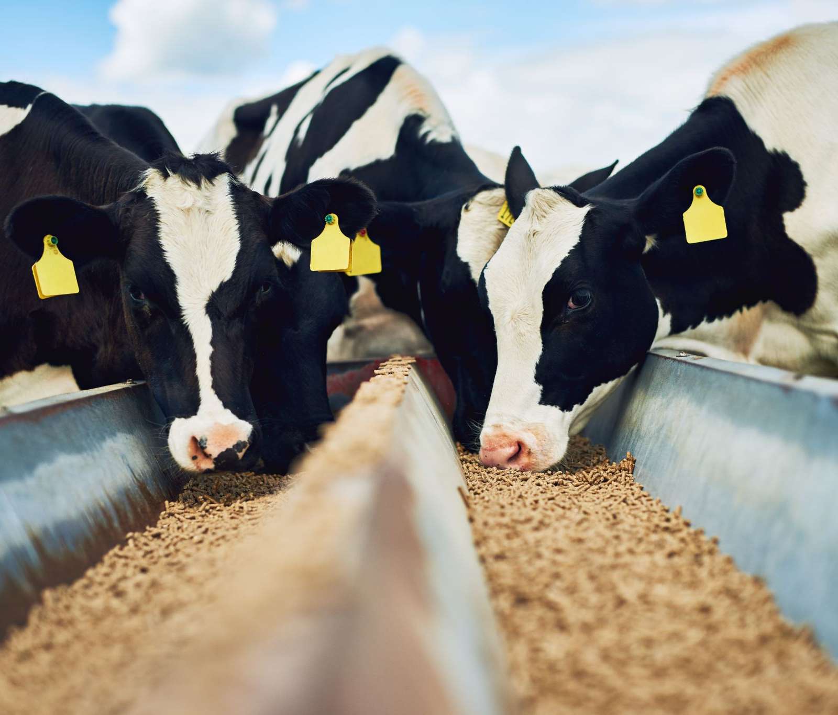
What are cattle?
They sleep in the barn
Our children point at them
We aren’t usually close enough to be licked by them
We pay people to clean their messes
We use or eat them

Slide 10
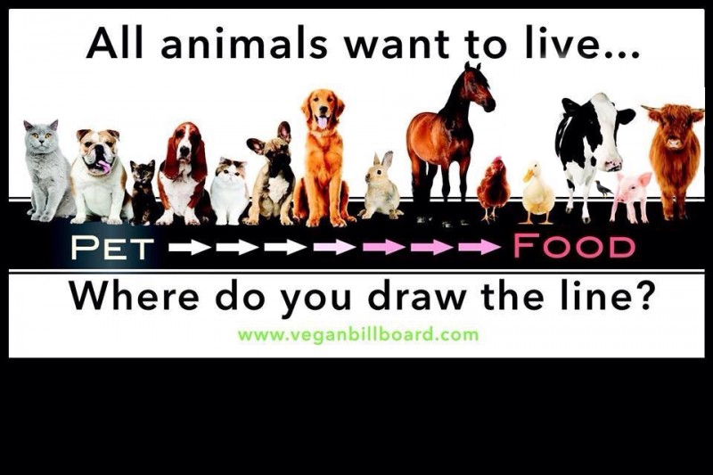

Slide 11
Pets, cattle, or just plain stupid?

Slide 12
We use regional bird species to name our servers

Slide 13
Pets

Slide 14
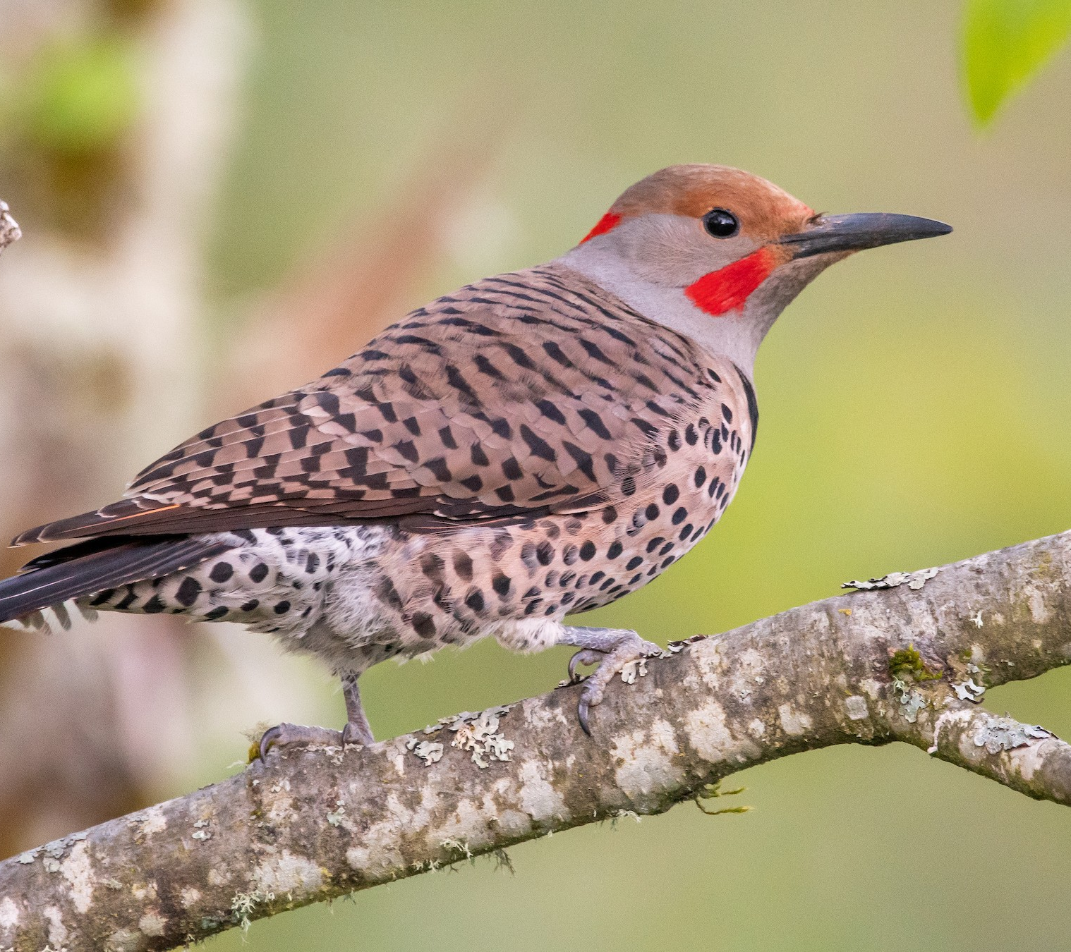
What datacenter regions fall into the range of this bird?
Red-shafted Flicker

Slide 15
Just plain stupid

Slide 16
When a production host goes down, we just replace it

Slide 17
Cattle

Slide 18
When a host gets over loaded, we give it more resources

Slide 19
Pets

Slide 20
We assign different color backgrounds to our server desktops based on environment

Slide 21
Cattle

Slide 22
We depend on automated processes and never manually verify our system configurations

Slide 23
Cattle

Slide 24
We have step by step instructions with screenshots on how to deploy our software into production

Slide 25
Pets

Slide 26
Infrastructure
Pets
Fun naming convention
When broken, is fixed
When overloaded, grown
Manually configured
Carefully reviewed
Documented with screenshots
Cattle
Standardized, numbered naming
When broken, is replaced
When overloaded, multiplied
Automated and uniform configuration
Automated review
Documented with code

Slide 27

Pet problem signs
Creating more tech debt than you ever intended
Spending too much time working through manual steps
Failing to fulfill other obligations
Performing risky changes
Continued personalized care regardless of other problems

Slide 28
DSM 5 criteria for substance abuse disorder
Taking the substance in larger amounts or for longer than you're meant to
Wanting to cut down or stop using the substance but not managing to
Spending a lot of time getting, using, or recovering from use of the substance
Cravings and urges to use the substance
Not managing to do what you should at work, home, or school because of substance use
Continuing to use, even when it causes problems in relationships
Giving up important social, occupational, or recreational activities because of substance use
Using substances again and again, even when it puts you in danger
Continuing to use, even when you know you have a physical or psychological problem that could have been caused or made worse by the substance
Needing more of the substance to get the effect you want (tolerance)
Development of withdrawal symptoms, which can be relieved by taking more of the substance

Slide 29
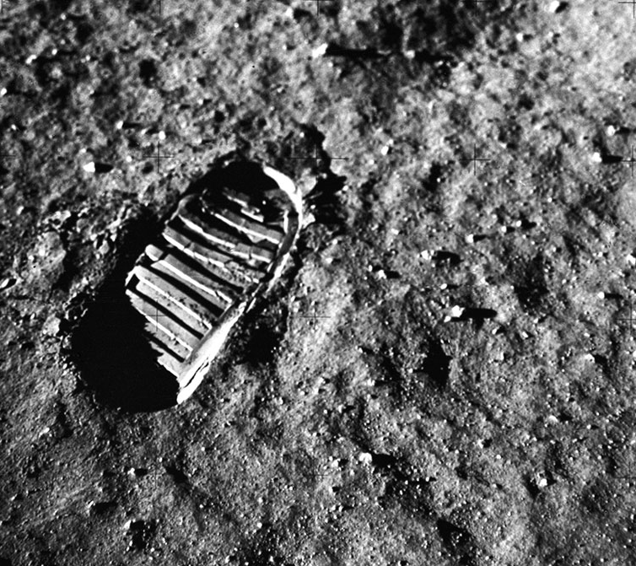
Step One
Admitting you have a problem.
Realizing that you need help:
External support
Internal support

Slide 30
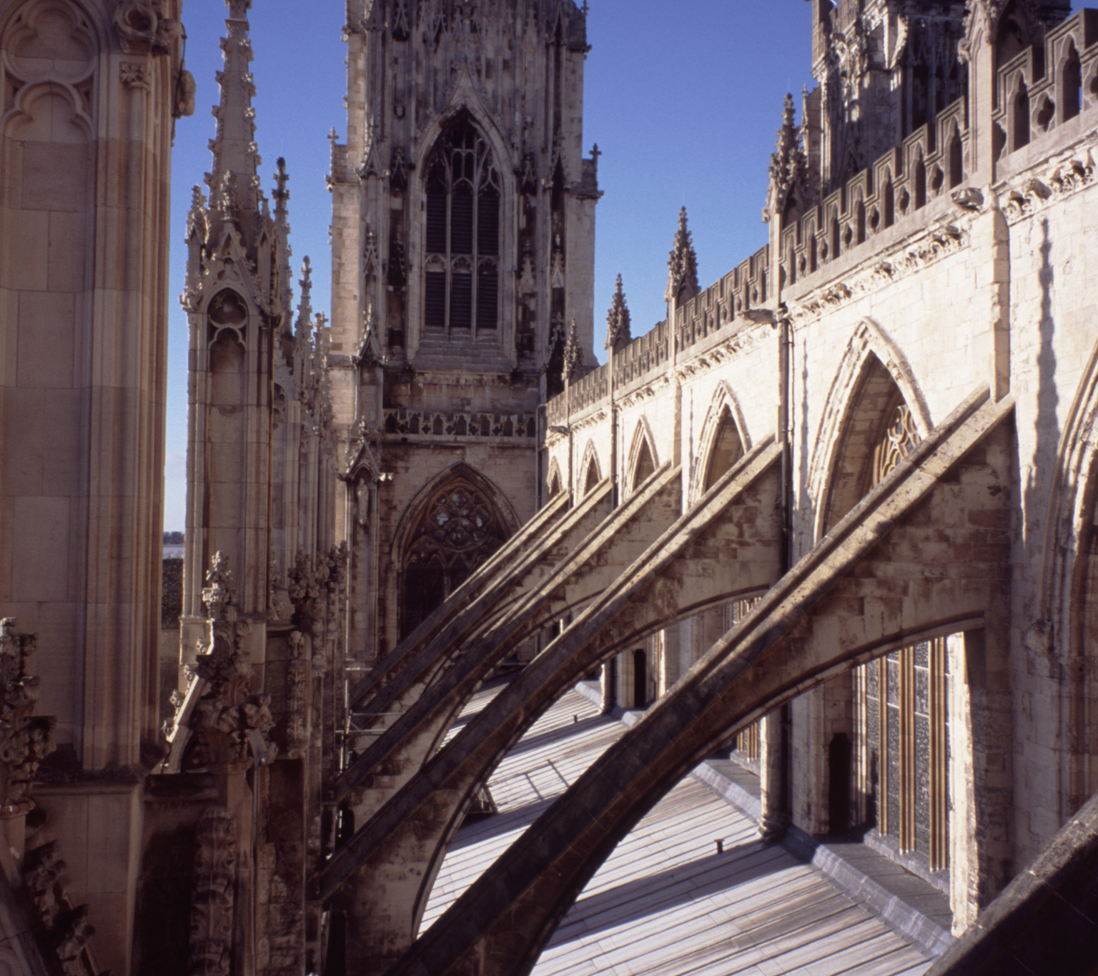
External Support
Leadership buy in
Peers with skills
Supported platform and tooling

Slide 31
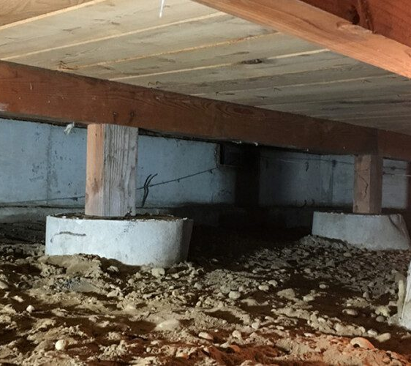
Internal Support
Mindset
Skills

Slide 32

Mindset
Imperative vs Declarative
Idempotency
Reusability
Standardization
Configuration Drift
Thinking in Units

Slide 33
Imperative vs. Declarative
Imperative
You describe how you want code to execute.
Declarative
You describe the results of the code execution.
Considered an abstraction above imperative.

Slide 34
Imperative vs. Declarative
$resourceGroupName = "example-resources"
$location = "West US"
$containerAppEnvironmentName = "example-environment"
$containerAppName = "example-app"
$logAnalyticsWorkspaceName = "acctest-01"
Connect-AzAccount
New-AzResourceGroup -Name $resourceGroupName -Location $location
$logAnalyticsWorkspace = New-AzOperationalInsightsWorkspace -ResourceGroupName $resourceGroupName `
-Name $logAnalyticsWorkspaceName -Location $location -Sku "PerGB2018" -RetentionInDays 30
$containerAppEnvironment = New-AzContainerAppManagedEnvironment -ResourceGroupName $resourceGroupName `
-Name $containerAppEnvironmentName -Location $location `
-LogAnalyticsWorkspaceId $logAnalyticsWorkspace.ResourceId
New-AzContainerApp -ResourceGroupName $resourceGroupName `
-Name $containerAppName -Location $location `
-ManagedEnvironmentId $containerAppEnvironment.Id `
-Image "mcr.microsoft.com/k8se/quickstart:latest"
-Cpu 0.25 -Memory "0.5Gi" `
-IngressExternalEnabled $true -TargetPort 80
resource "azurerm_resource_group" "example" {
name = "example-resources"
location = "West US"
}
resource "azurerm_log_analytics_workspace" "example" {
name = "acctest-01"
location = azurerm_resource_group.example.location
resource_group_name = azurerm_resource_group.example.name
sku = "PerGB2018"
retention_in_days = 30
}
resource "azurerm_container_app_environment" "example" {
name = "Example-Environment"
location = azurerm_resource_group.example.location
resource_group_name = azurerm_resource_group.example.name
log_analytics_workspace_id = azurerm_log_analytics_workspace.example.id
}
resource "azurerm_container_app" "example" {
name = "example-app"
container_app_environment_id = azurerm_container_app_environment.example.id
resource_group_name = azurerm_resource_group.example.name
revision_mode = "Single"
template {
container {
name = "examplecontainerapp"
image = "mcr.microsoft.com/k8se/quickstart:latest"
cpu = 0.25
memory = "0.5Gi"
}
}
}

Slide 35
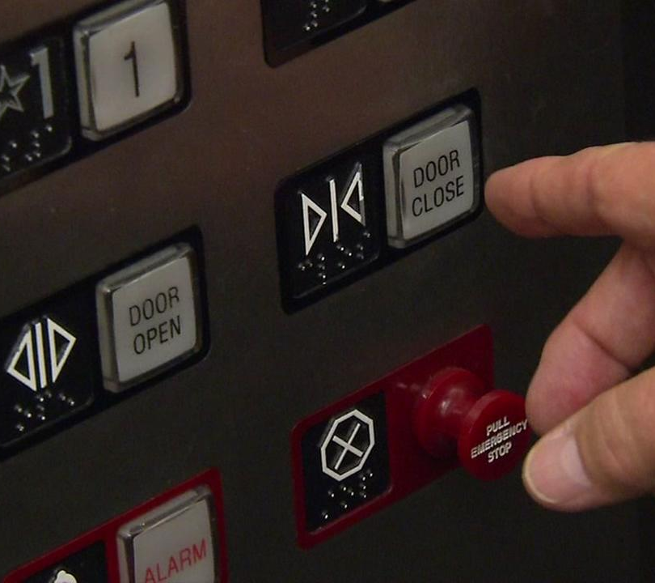
Idempotency
Running the process multiple times has no additional effects:
Close elevator door button
Cutting lumber to length
Locking a car
Get-* / HTTP GET

Slide 36
Idempotency
$existingContainerApp = Get-AzContainerApp -ResourceGroupName $resourceGroupName `
-Name $containerAppName -ErrorAction SilentlyContinue
$splat = @{
ResourceGroupName = $resourceGroupName
Name = $containerAppName
Image = "mcr.microsoft.com/k8se/quickstart:latest"
Cpu = 0.25
Memory = "0.5Gi"
IngressExternalEnabled = $true
TargetPort = 80
}
if ($existingContainerApp) {
# Update the existing Container App
Update-AzContainerApp @splat
Write-Host "Container App '$containerAppName' updated successfully."
} else {
# Create a new Container App
New-AzContainerApp @splat
Write-Host "Container App '$containerAppName' created successfully."
}
# What about all the other configurations on the container app?
resource "azurerm_container_app" "example" {
name = "example-app"
container_app_environment_id = azurerm_container_app_environment.example.id
resource_group_name = azurerm_resource_group.example.name
revision_mode = "Single"
template {
container {
name = "examplecontainerapp"
image = "mcr.microsoft.com/k8se/quickstart:latest"
cpu = 0.25
memory = "0.5Gi"
}
}
}

Slide 37
Reusability
Function New-IdempotentContainerApp {
param (
[string]$ResourceGroupName,[string]$Name,[string]$Image,[double]$Cpu,[string]$Memory,
[bool]$IngressExternalEnabled,[int]$TargetPort
) $containerApp = @{
ResourceGroupName = $ResourceGroupName
Name = $Name
Image = $Image
Cpu = $Cpu
Memory = $Memory
IngressExternalEnabled = $IngressExternalEnabled
TargetPort = $TargetPort
} $existingContainerApp = Get-AzContainerApp -ResourceGroupName $ResourceGroupName -Name $Name `
-ErrorAction SilentlyContinue
if ($existingContainerApp) {
Update-AzContainerApp @containerApp
Write-Host "Container App '$containerAppName' updated successfully."
} else {
New-AzContainerApp @containerApp
Write-Host "Container App '$containerAppName' created successfully."
}
}
New-IdempotentContainerApp -ResourceGroupName $resourceGroupName -Name $containerAppName `
-Image "mcr.microsoft.com/k8se/quickstart:latest" -Cpu 0.25 -Memory "0.5Gi" `
-IngressExternalEnabled $true -TargetPort 80
module "container_app" {
source = "./modules/container_app"
resource_group_name = "example-resources"
location = "West US"
log_analytics_workspace_name = "acctest-01"
log_analytics_workspace_sku = "PerGB2018"
log_analytics_retention_in_days = 30
container_app_environment_name = "Example-Environment"
container_app_name = "example-app"
revision_mode = "Single"
container_name = "examplecontainerapp"
container_image = "mcr.microsoft.com/k8se/quickstart:latest"
container_cpu = 0.25
container_memory = "0.5Gi"
}

Slide 38
Standardization
for ($x = 0; $x -lt 10; $x++) {
New-IdempotentContainerApp -ResourceGroupName $resourceGroupName -Name "$containerAppName-$x" `
-Image "mcr.microsoft.com/k8se/quickstart:latest" -Cpu 0.25 -Memory "0.5Gi" `
-IngressExternalEnabled $true -TargetPort 80
}
module "container_app" {
source = "./modules/container_app"
count = 10
resource_group_name = "example-resources"
location = "West US"
log_analytics_workspace_name = "acctest-01"
log_analytics_workspace_sku = "PerGB2018"
log_analytics_retention_in_days = 30
container_app_environment_name = "Example-Environment"
container_app_name = "example-app-${count.index}"
revision_mode = "Single"
container_name = "examplecontainerapp"
container_image = "mcr.microsoft.com/k8se/quickstart:latest"
container_cpu = 0.25
container_memory = "0.5Gi"
}

Slide 39
Configuration Drift
Describe "Container App Configuration Tests" {
$resourceGroupName = "example-resources"
$containerAppBaseName = "example-app"
for ($x = 0; $x -lt 10; $x++) {
$containerAppName = "$containerAppBaseName-$x"
$containerImage = "mcr.microsoft.com/k8se/quickstart:latest"
$containerApp = Get-AzContainerApp -ResourceGroupName $resourceGroupName `
-Name $containerAppName -ErrorAction SilentlyContinue
It "Container App $containerAppName should exist" {
$containerApp | Should -Not -BeNullOrEmpty
}
It "Container App $containerAppName should have the correct image" {
$containerApp.Properties.Template.Containers[0].Image | Should -Be $containerImage
}
}
}
Invoke-Pester -Path .\ContainerApp.Tests.ps1
terraform init
terraform plan

Slide 40
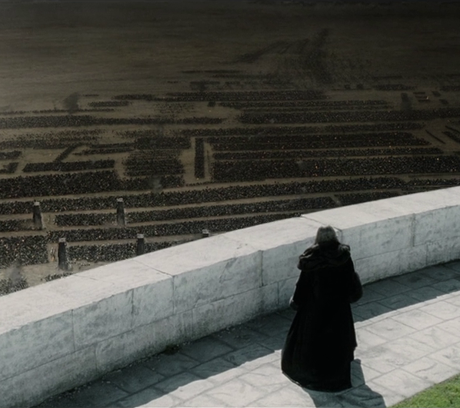
Thinking in Units
1k servers become:
1 unit of web servers for application A
1 unit of app servers for application A
1 unit of database servers for application A
Etc.
Modern architecture:
Microservices
Cell-based

Slide 41

Skills
Infrastructure as code
Terraform / OpenTofu
ARM Templates / Bicep
CloudFormation
Pulumi
Configuration as code
Ansible
PowerShell DSC / DSC
Chef
Puppet
Saltstack

Slide 42
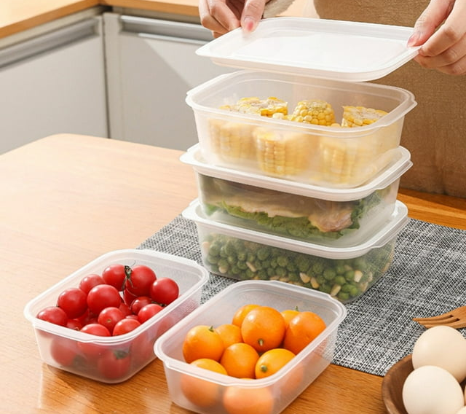
Containers
Built with a Dockerfile
Deployed into Kubernetes with YAML / Helm
Easily configured for scaling

Slide 43

What next?
Scaling
Change Management
Disaster recovery
Environment management

Slide 44
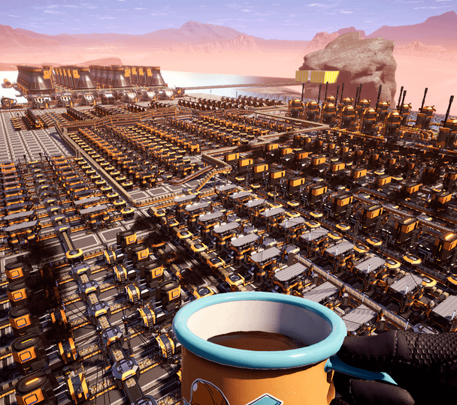
Scaling
As one unit, the number of compute resources no longer matter
Just need some scaling rules and load balancing
VM scaling is supported by cloud providers:
Azure VM Scale Set
AWS EC2 Scaling Group
GCP Managed Instance Groups

Slide 45
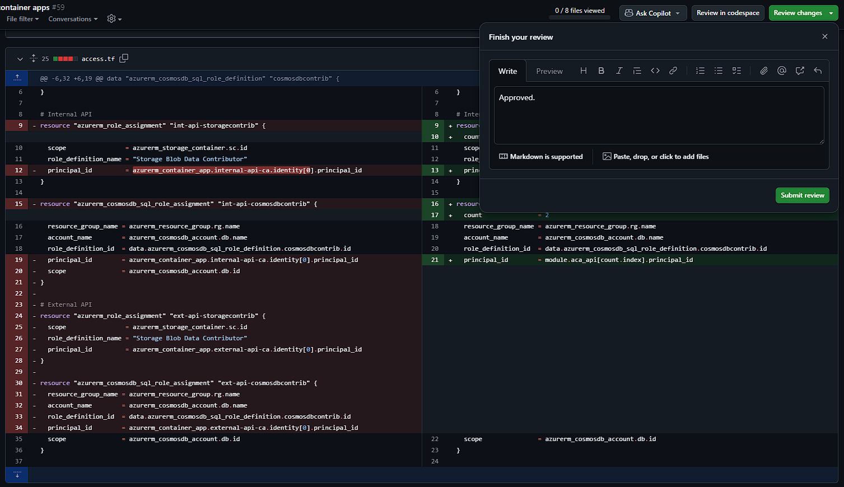
Change Management

Slide 46

Disaster Recovery
Infrastructure is now disposable
Data is still valuable
DR becomes: redeploy to unaffected region where the data was already being synchronized

Slide 47
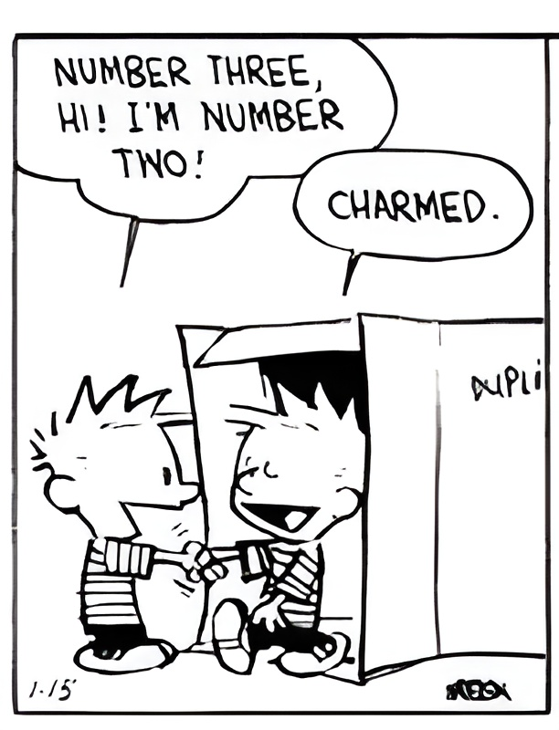
Environment Management
The difference between environments is expressed with variables
Need to mirror production exactly to test? Deploy, test, and destroy.

Slide 48

Closing thoughts

Slide 49

THANK YOU
Feedback is a gift. Please review this session

